Slide 1

Information theory
Senior lecturer: Nurkamilya A.Daurenbayeva

Slide 2
Context | Definition
Mathematical Definition | Information theory is a branch of applied mathematics that quantifies information using concepts such as entropy, mutual information, and channel capacity. It focuses on the mathematical foundations of data transmission, encoding, and compression.
Communication Theory Definition | Information theory studies how information is transmitted over communication channels. It addresses challenges in data encoding, error minimization, and maximizing the rate of successful transmission given constraints like noise and bandwidth.
Statistical Definition | In statistical terms, information theory provides a framework for understanding the amount of uncertainty or randomness in a data source. It uses concepts like entropy to measure data unpredictability and develop methods for optimal data representation and compression.
Engineering Definition | From an engineering perspective, information theory deals with the design and analysis of systems for transmitting and storing data. It encompasses techniques for signal processing, error correction, and data compression to enhance the efficiency and reliability of communication systems.
Information Processing Definition | Information theory is the study of how information is processed, represented, and transformed. It examines how to encode information for various purposes, such as reducing redundancy, improving clarity, and ensuring security in data handling and transmission.
Shannon's Definition | According to Claude Shannon, the founder of information theory, it is "the scientific study of the transmission of information over a communication channel." Shannon introduced the concept of quantifying information and analyzing the limits of communication systems based on information amount and noise levels.

Slide 3
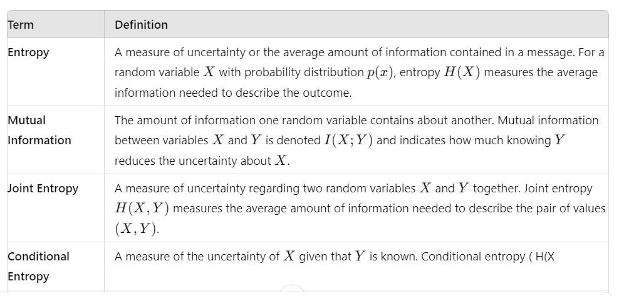

Slide 4
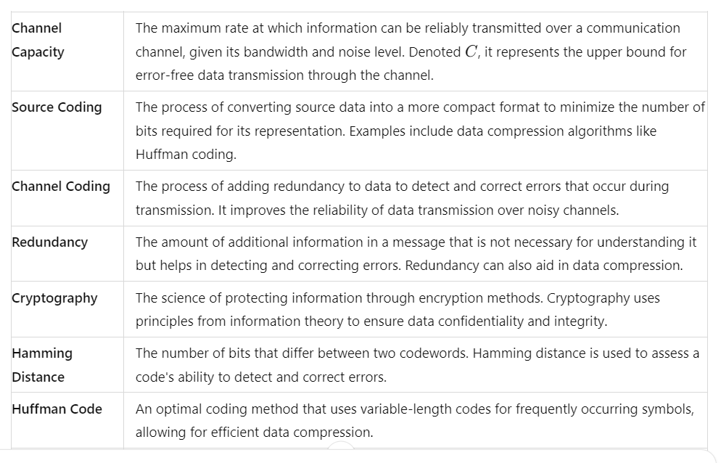

Slide 5
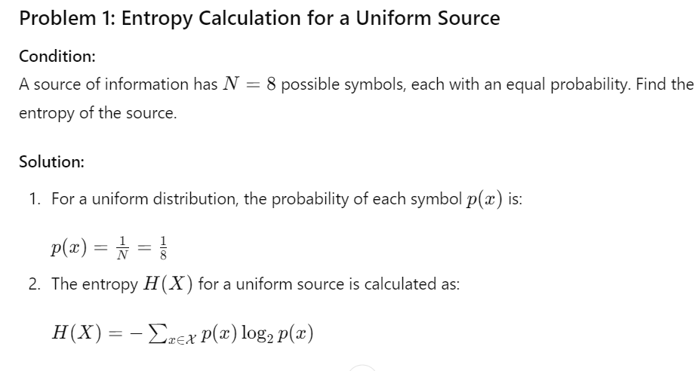

Slide 6
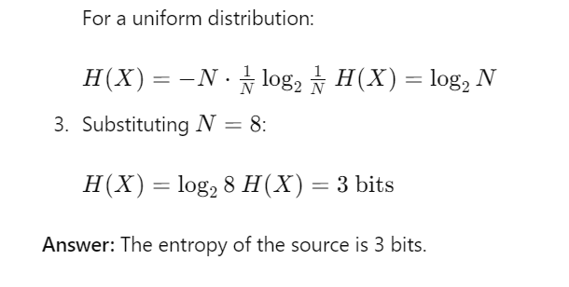

Slide 7
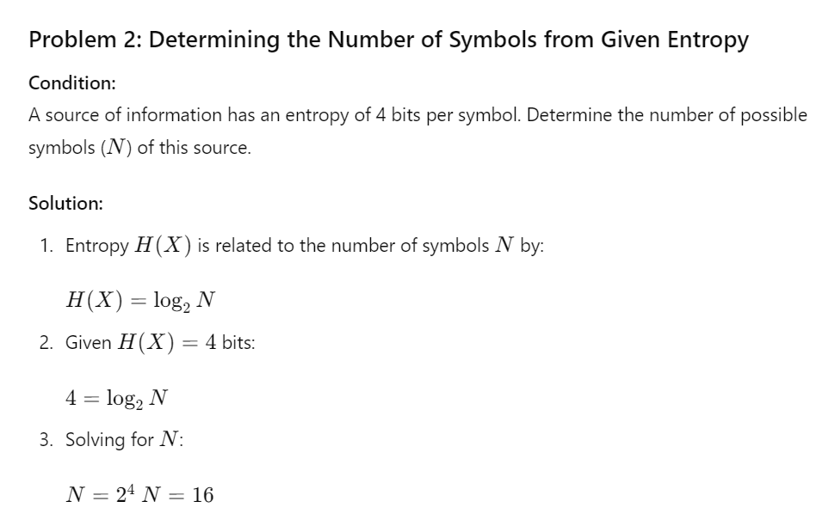
Answer: The number of symbols is 16.

Slide 8
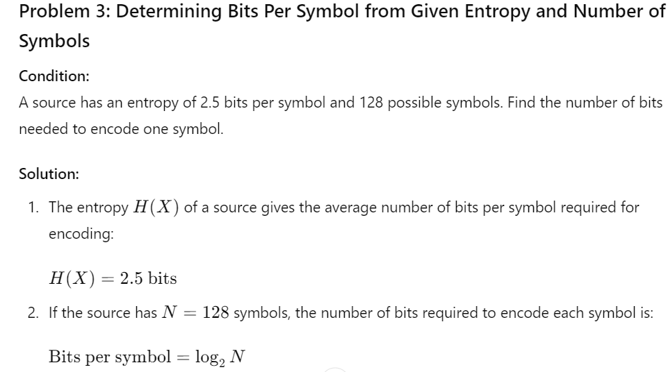

Slide 9
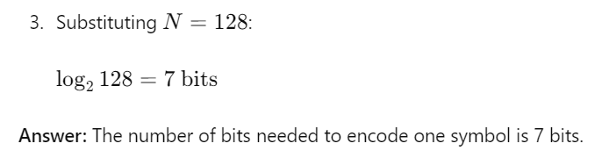

Slide 10
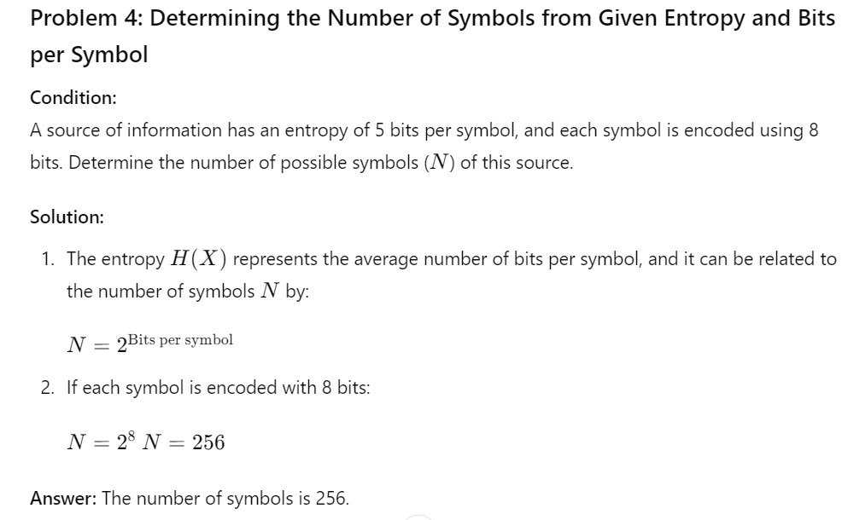

Slide 11
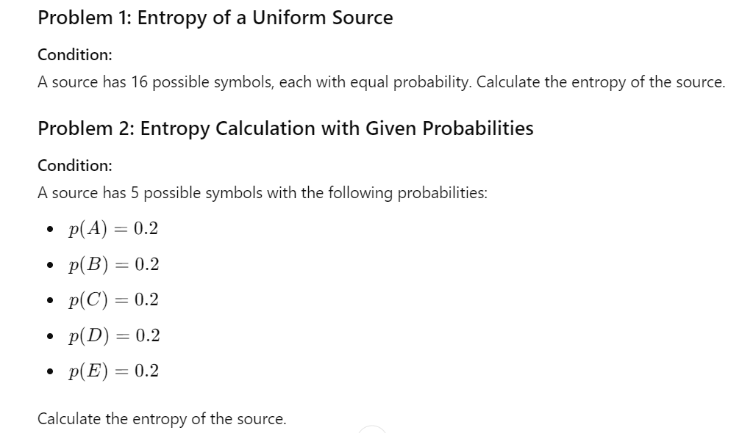
Problems

Slide 12
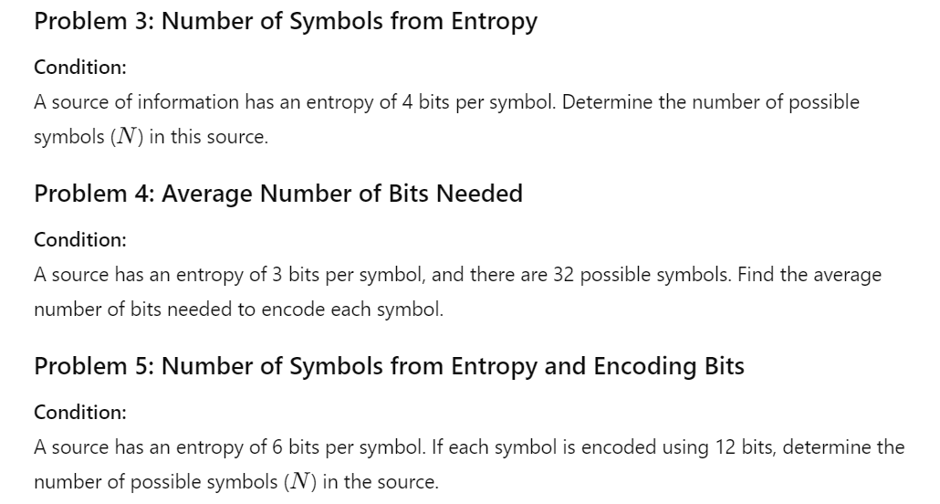

Slide 13
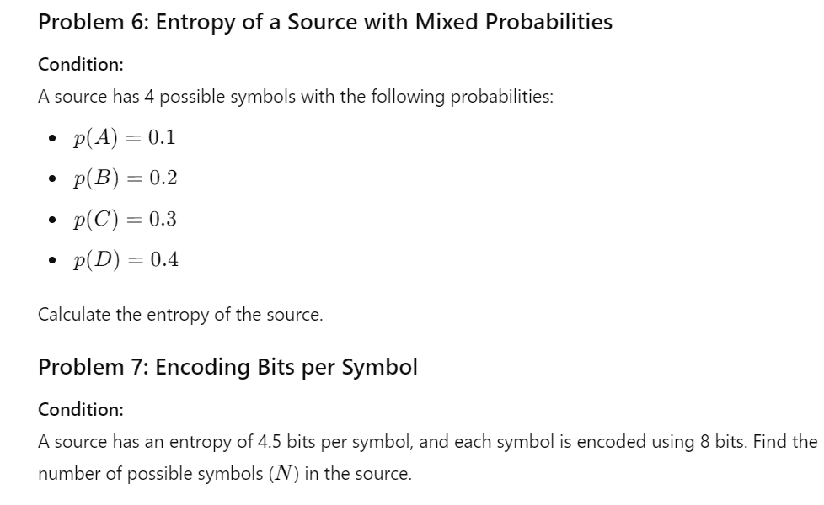

Slide 14
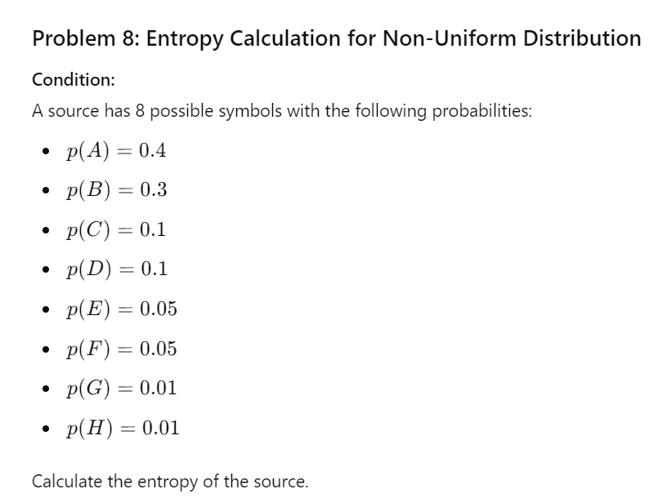

Slide 15
